Slide 1
2046
(Poppies, 2016)

Slide 2
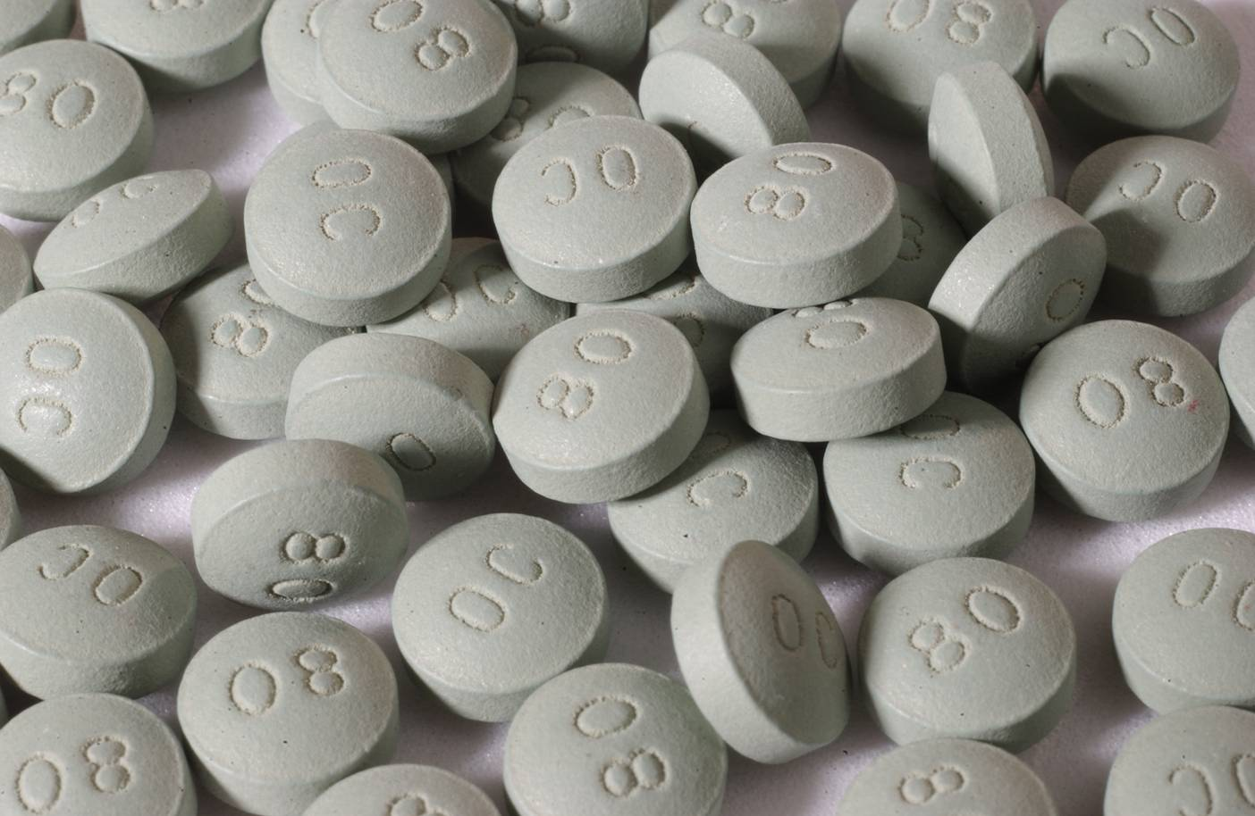
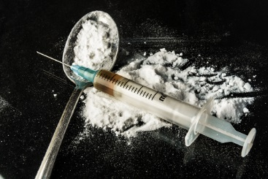
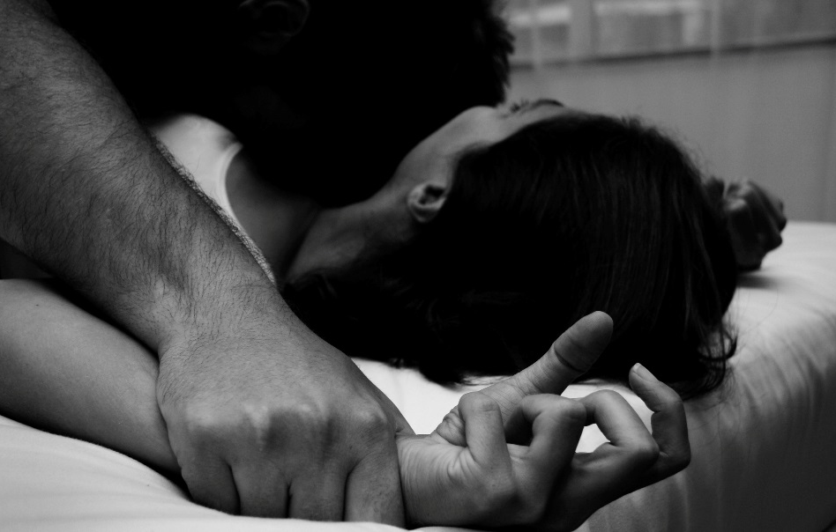
(OxyContin detox, rehab, and treatment programs, 2016)
(Heroin addiction, 2016)
(Domestic violence & child neglect, 2016)
(The danger of desensitizing “rape, 2016)

Slide 3
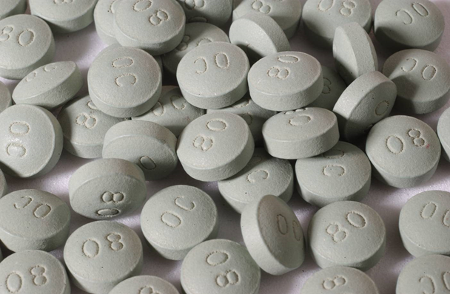
What is an opiate?
Opium
Juice from a poppy plant
Opioids
Synthetic opiates: OxyContin
Opiates/ Narcotics
Codeine, morphine, and heroin

Slide 4
Florida Opiate Use (local)
According to NPR’s Greg Allen, Florida is the epicenter of a prescription drug abuse epidemic. Each day in communities from Jacksonville to Fort Lauderdale, thousands of doses of powerful narcotics like oxycodone are dispensed in pain clinics — storefront operations also called "pill mills.” (Florida's Drug Abuse Epidemic, 2011)
(Florida use, 2014)

Slide 5
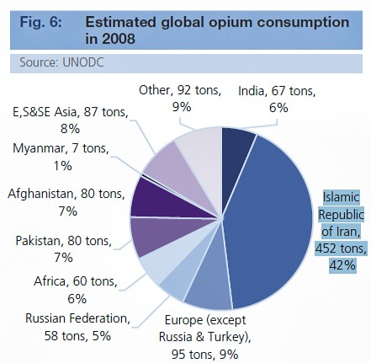
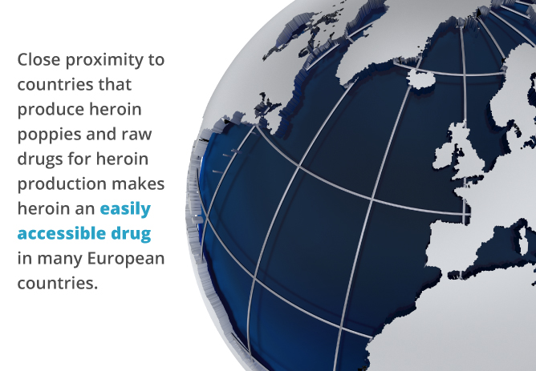
Global opiate use
The use of opiates, heroin in particular, is causing widespread health and social problems in many countries. (Opiates, 2016)
(Drug use in the European union, 2015)
(Demand for opium, 2009)

Slide 6
Group question: Is opiate use becoming an issue? Personal Question: Is the use of opiates a social issue?
Social Issue:
A problem, important subject, or occurrence that causes someone to become isolated from anything involving the act of being social. (Issue, 2016) (Social, 2016)

Slide 7
Thesis & Concession
When parents use opiates, social issues can arise in their children.
Synthetic opiates are used to treat social anxiety.
The use of opiates has been linked to various instances of sexual assault.
(Do Filibusters Stall the Senate or Give It Purpose?, 2012)

Slide 8
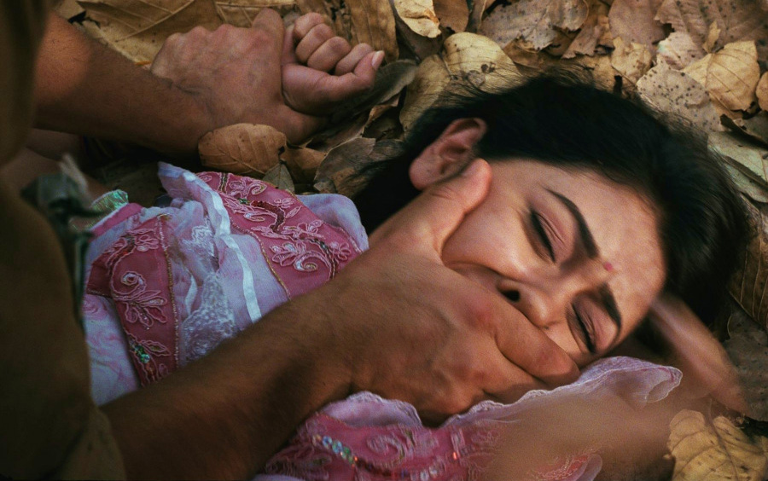
Thesis: Reason 1
Opiate use is a social issue because its use has been linked to instances of sexual assault.
(Reform the Rape Provision in the Jamaica Sexual Offences Act, 2015)
(Activist hub, 2016)

Slide 9
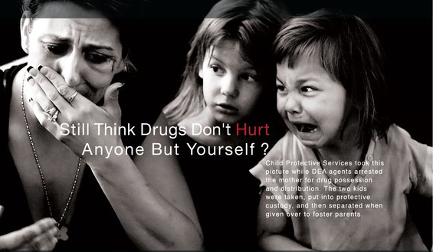
Thesis: Reason 2
Opiate use is a social issue because children who are exposed to their parents’ opiate use can result to having social issues.
Social anxiety, depression, and more
Witnessing their parents high
Foster care/ separation from siblings
Not having the opportunity to a “normal” childhood
(Drug addiction in our family, 2016)

Slide 10
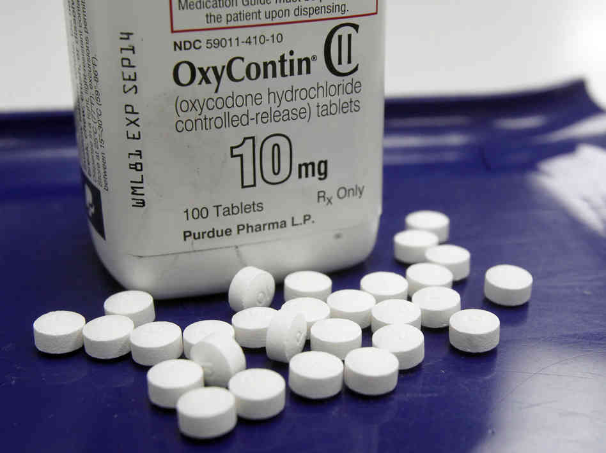
Concession
Opiate use is not a social issue because Synthetic opiates such as OxyContin are used to treat social anxiety.
(Understand the potential implication on your mental health, 2016)
(Summertime social for teens, 2016)
(Greiss, 2012)

Slide 11
Reflection
At the beginning of my research, I was adamant on the view that opiate use is a social issue.
After thorough research, I’ve become sympathetic to the opposing view that opiate use is not a social issue.
I have learned a lot about opiate use and how it can actually treat social issues such as anxiety. Therefore, I’m not as adamant about my view as before.
However, I am still in agreeance with my original view that opiate use is a social issue. Nonetheless, the need for further research is most definitely present.
(Reflect, 2016)

Slide 12
References
(2016). Retrieved May 12, 2016, from http://www.merriam-webster.com/dictionary/social
(2016). Retrieved May 12, 2016, from http://www.merriam-webster.com/dictionary/issue
Article of the Week: Reform the Rape Provision in the Jamaica Sexual Offences Act. (2015). Retrieved May 03, 2016, from https://monalawprecedent.wordpress.com/2015/04/01/article-of-the-week-reform-the-rape-provision-in-the-jamaica-sexual-offences-act/
Decline in Drug Overdose Deaths After State Policy Changes — Florida, 2010–2012. (2014). Retrieved May 03, 2016, from http://www.cdc.gov/mmwr/preview/mmwrhtml/mm6326a3.htm
Do Filibusters Stall the Senate or Give It Purpose? (2012). Retrieved May 07, 2016, from http://www.nytimes.com/roomfordebate/2012/12/02/do-filibusters-stall-the-senate-or-give-it-purpose
DOMESTIC VIOLENCE & CHILD NEGLECT. (2016). Retrieved May 03, 2016, from http://www.lawofficesofbrucethrasher.com/home/child-abuse-neglect
D. S. (2016). Suwanwela C. Retrieved April 21, 2016, from http://europepmc.org/abstract/med/3535959
Drug addiction in our family. (2016). Retrieved May 03, 2016, from https://www.pinterest.com/jenifercenters/drug-addiction-in-our-family/
Fields, H. L. (2016). Search, discover, network. Retrieved April 21, 2016, from http://profiles.ucsf.edu/howard.fields
Fields, H. L. (2016). The Doctor's Dilemma: Opiate analgesics and chronic pain. Retrieved April 21, 2016, from http://www.ncbi.nlm.nih.gov/pmc/articles/PMC3073133/
Forced vaccinations are rape!! watch your child being raped, that's how I feel about forced vaccines! ITS A LINE IN THE SAND! (2015). Retrieved May 03, 2016, from http://activistshub.com/forced-vaccinations-are-rape-watch-your-child-being-raped-thats-how-i-feel-about-forced-vaccines-its-a-line-in-the-sand/
Greg Allen. (2016). Retrieved May 11, 2016, from http://www.npr.org/people/2100171/greg-allen
Heroin Addiction Treatment | Narconon Arrowhead. (2016). Retrieved May 03, 2016, from http://www.heroinaddiction.com/
Hogan, D. M. (2016). Retrived April 21, 2016, from https://www.tcd.ie/childrensresearchcentre/assets/pdf/Publications/social&psychological.pdf
Is Social Anxiety Giving You Panic Attacks? (2016). Retrieved May 03, 2016, from https://www.anxiety.org/social-anxiety-disorder-panic-attacks-specifier

Slide 13
References
How Does the World View Drug and Alcohol Addiction. (2015). Retrieved May 03, 2016, from http://www.bestrehabcenter.com/blog/drug-use-and-addiction-around-the-world/
On OxyContin, It's Time for the Generic Industry to Step Up and Step Out. (2012). Retrieved May 03, 2016, from http://opined.ca/2012/11/on-oxycontin-its-time-for-the-generic-industry-to-step-up-and-step-out/
Opiates. (2016). Retrieved May 12, 2016, from http://www.who.int/substance_abuse/facts/opiates/en/
OxyContin Detox, Rehab, and Treatment Programs | Full Circle Treatment. (2016). Retrieved May 03, 2016, from http://www.findadetoxnow.com/drug-treatment/oxycontin-detox-rehab-treatment-programs/
Our Mission. (2016). Retrieved April 21, 2016, from https://www.ncbi.nlm.nih.gov/home/about/
Parents with special problems: Alcoholism and opiate addiction. (2016). Retrieved April 21, 2016, from http://www.sciencedirect.com/science/article/pii/0145213480900332
Poppies. (2016). Retrieved May 03, 2016, from http://oz.wikia.com/wiki/Poppies
Reflect. (2016). Retrieved May 03, 2016, from http://www.keyword-suggestions.com/cmVmbGVjdA/
Result Filters. (2016). Retrieved April 20, 2016, from http://www.ncbi.nlm.nih.gov/pubmed/10369321
Summertime social for teens. (2016). Retrieved May 03, 2016, from http://www.greatschools.org/parenting/social-skills/slideshows/2739-friendship-skills-for-tweens-and-teens.gs
The danger of desensitizing. (2015). Retrieved May 03, 2016, from http://legionofleia.com/2015/12/the-danger-of-desensitizing-rape/
The 'Oxy Express': Florida's Drug Abuse Epidemic. (2016). Retrieved May 11, 2016, from http://www.npr.org/2011/03/02/134143813/the-oxy-express-floridas-drug-abuse-epidemic
Trinity College Dublin. (2016). Retrieved April 21, 2016, from https://www.tcd.ie/childrensresearchcentre/
UNESCO Office in Bangkok: Charas Suwanwela. (2016). Retrieved April 21, 2016, from http://www.unescobkk.org/en/education/apeid/apeid-international-conference/11apeidconf/speakers-and-speeches/charas-suwanwela/
United Nations World Drug Report 2010 and Iran. (2016). Retrieved May 03, 2016, from http://payvand.com/blog/blog/2010/06/24/united-nations-world-drug-report-2010-and-iran/

